Slide 1

Vel Tech Rangarajan Dr. Sagunthala R&D Institute of Science and Technology
School of Computing
Department of Computer Science and Engineering
10211CS224 / FULL STACK APPLICATION DEVELOPMENT (JAVA)
PROJECT REVIEW : MILESTONE PROJECT – 2
Date: 17-04-2026
SMART CAMPUS EVENT MANAGEMENT SYSTEM
SDG: SDG N0:4 – Quality Education
Presented By:
D. Ameer sohel– VTU30317- 23UECS2060
Courses Handling Faculty:
Dr. Hafizur Rahman

Slide 2
INTRODUCTION
INTRODUCTION
Managing campus events manually is time-consuming and inefficient
Students often miss important event updates and registration deadlines
Lack of a centralized platform creates confusion
Organizers face difficulty in handling registrations and communication
The system provides a digital solution for event management
It allows easy event creation, registration, and tracking
Improves communication between students and organizers
Enhances overall campus engagement and efficiency
1
2
3
4
5
6
7
8
9

Slide 3
PROBLEM STATEMENT
Event management in colleges is mostly manual or poorly organized
Students do not receive timely information about events
No single platform to view and manage all events
Registration process is slow and error-prone
Organizers struggle to manage participant data
Communication gaps lead to missed opportunities
Data is not stored properly for future reference
Need for an automated, reliable, and centralized system
1
2
3
4
5
6
7
8
9

Slide 4
OBJECTIVE(S)
To design and develop a Smart Campus Event Management System
To implement an automated platform for event registration and management
1
2
3
4
5
6
7
8
9

Slide 5
PROPOSED SYSTEM
Provides a centralized platform for all campus events
Allows students to view and register for events online
Enables organizers to create and manage events easily
Sends notifications and updates to users
Maintains event records in a structured database
Reduces manual work and paperwork
Improves communication between students and organizers
Provides user-friendly interface for easy access
1
2
3
4
5
6
7
8
9

Slide 6
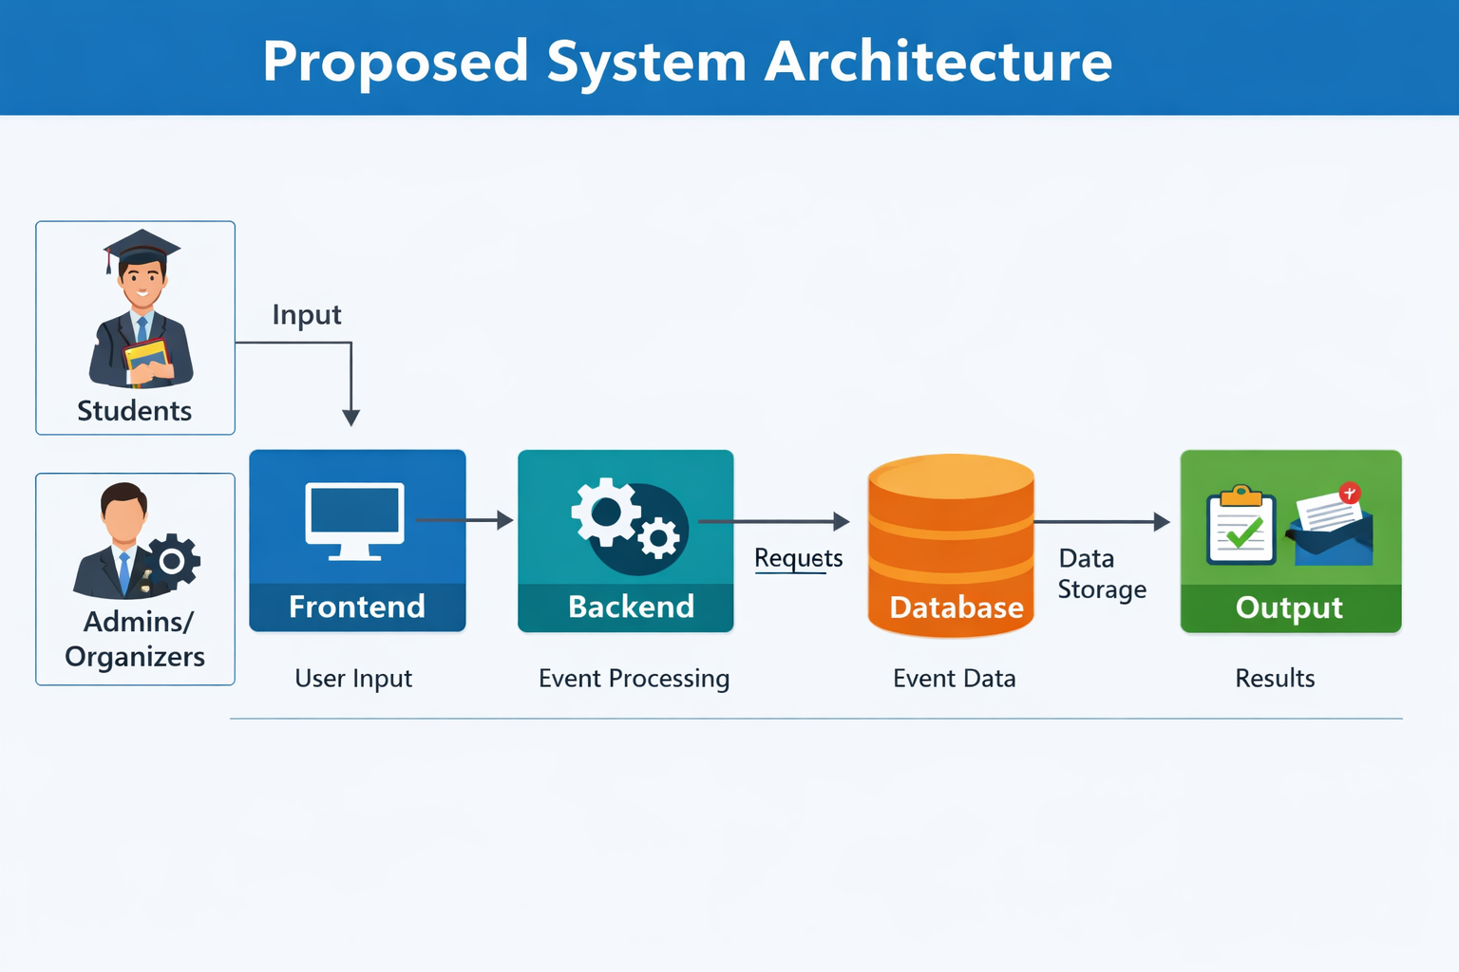
PROPOSED SYSTEM ARCHITECTURE
1
2
3
4
5
6
7
8
9

Slide 7
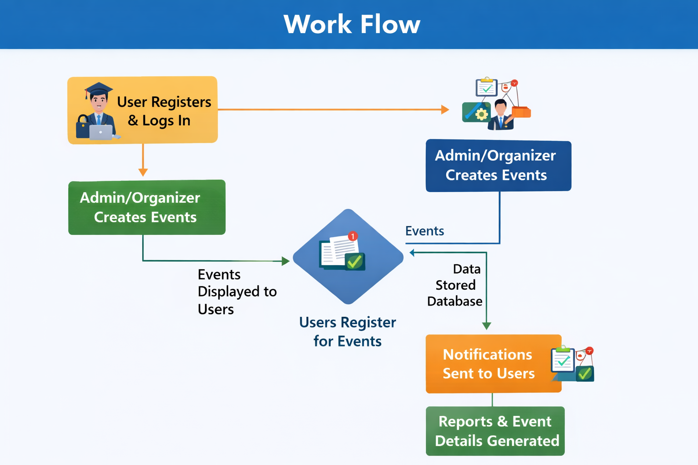
WORKFLOW
1
2
3
4
5
6
7
8
9

Slide 8
TECHNOLOGIES USED
Frontend:
HTML, CSS, JavaScript
Backend:
Java (Servlets/JSP)
Database:
MySQL
Tools:
Eclipse IDE, Apache Tomcat
Hardware/Software Requirements:
Computer with minimum 4GB RAM
Java JDK
Web browser
1
2
3
4
5
6
7
8
9

Slide 9
MODULE DESCRIPTION
Module 1: User Management
Handles user registration, login, and authentication.
Module 2: Event Management Allows creation, updating, and deletion of events.
Module 3: Registration Management Manages student registrations for events.
Module 4: Notification System Sends updates and alerts to users.
1
2
3
4
5
6
7
8
9

Slide 10
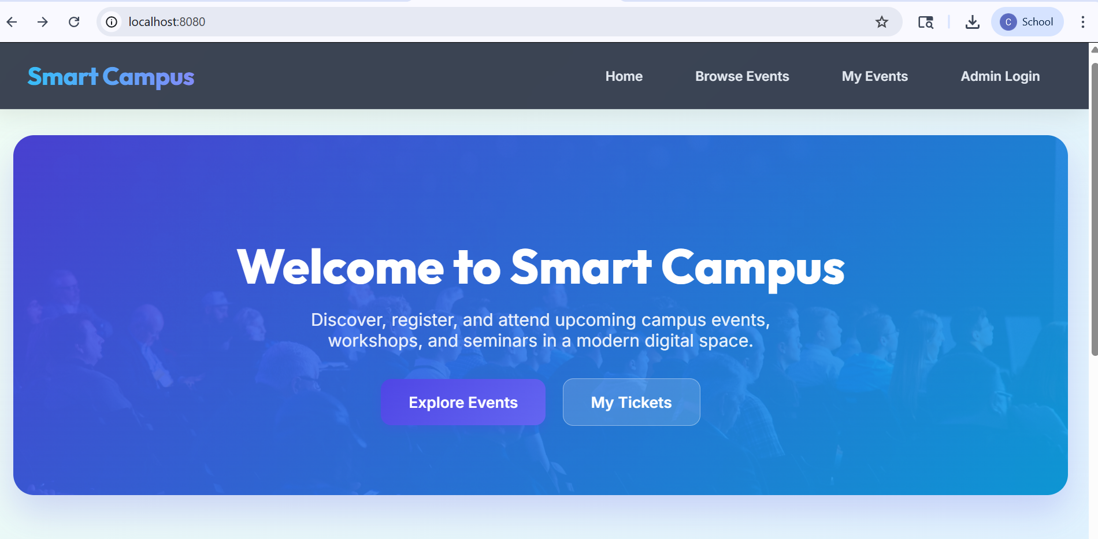
IMPLEMENTATION SCREENSHOTS
1
2
3
4
5
6
7
8
9

Slide 11
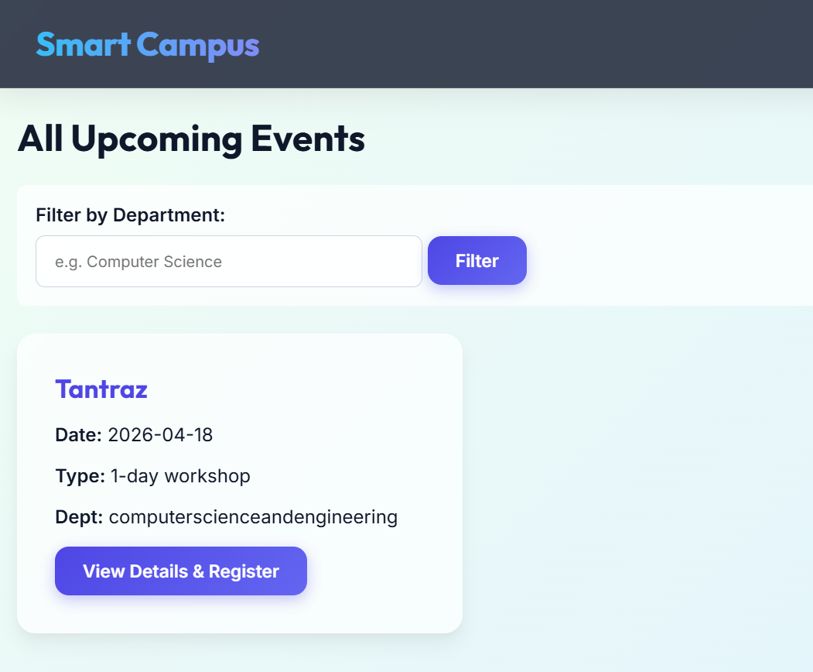
IMPLEMENTATION SCREENSHOTS
1
2
3
4
5
6
7
8(A)
9

Slide 12
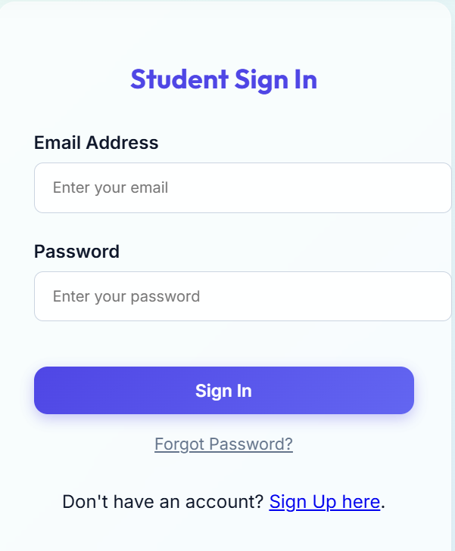
IMPLEMENTATION SCREENSHOTS
1
2
3
4
5
6
7
8(B)
9

Slide 13
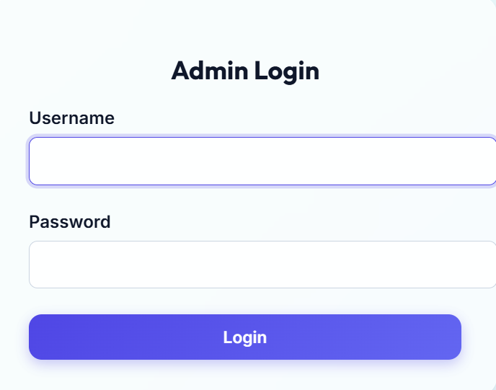
IMPLEMENTATION SCREENSHOTS
1
2
3
4
5
6
7
8(C)
9

Slide 14
ADVANTAGES & LIMITATIONS
Advantages:
Easy to use and efficient
Centralized system
Saves time and effort
Reduces manual errors
Limitations:
Requires internet connection
Initial setup cost
Depends on system maintenance
1
2
3
4
5
6
7
8
9

Slide 15
Thank you

